Slide 1

Location for new Retail Business London Borough Analysis
United KINDOM
by Magdalena Cieslak

Slide 2
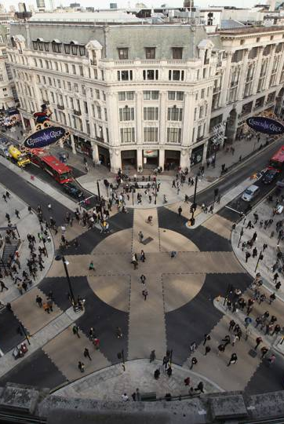
1. A description of the problem and a discussion of the background. London is one of the biggest city in Europe. Population 7.9 million on area 592.43 sq./mi. This city is attracting domestic and international investors. Analysis is for customers who planning open retails store and would like to know area better. I am planning to provide data for 32 London Boroughs about: area, population, earnings, domestic visitors spend and oversea visitor spend. I will also count correlation between them In second part I will get information about venues and categories. Then I will select venues related to retail. Finally I will form borough cluster for retail venue .
2. A description of the data and how it will be used to solve the problem.
Scraping London Borough data from Wikipedia website https://en.wikipedia.org/wiki/List_of_London_boroughs
Obtain csv. File of earnings & tourist data from government website
https://data.london.gov.uk/dataset/tourism-spend-estimates
https://data.london.gov.uk/dataset/earnings-workplace-borough
Problem: unable to find specific borough latitude and longitude file. Problem solution create own csv. File on base of Geo names organisation website https://www.geonames.org/
Collecting information about Venus using Foursquare API
Create locations and clusters map

Slide 3
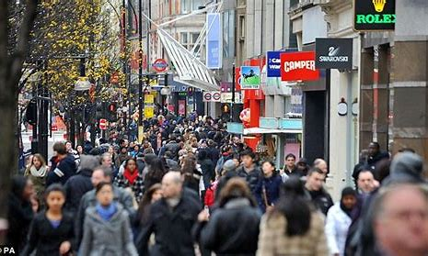
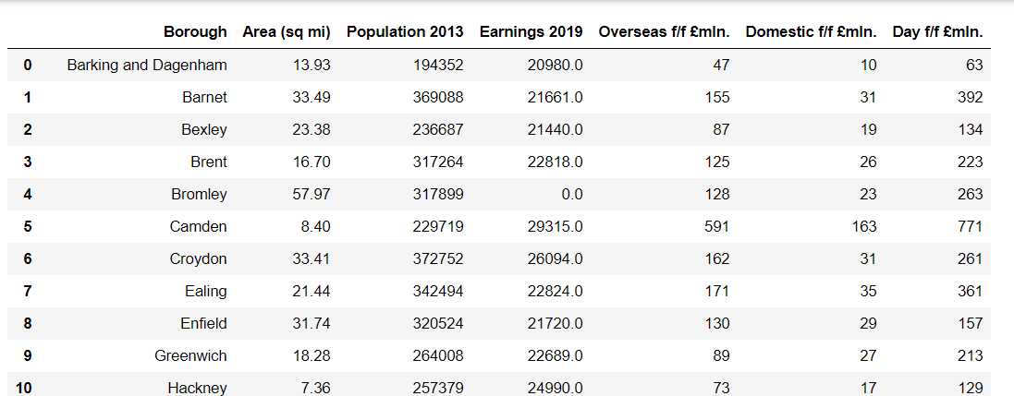
Methodology
Data Cleaning
I used Beautiful Soup library in order to scrap data from Wikipedia
Another dates were obtained from UK government page by using Panda to read the csv file.
I standardized and merged data to below format
Summary
London has 32 Boroughs
The biggest population : 1. Barnet , 2.Croydon, 3. Ealing
The highest income : 1. Tower Hamlets, 2. Westminster, 3. Islington
The highest Domestic spend by visitors: 1 Westminster, 2. Kingston and Chelsea, 3. Camden
The highest oversea spend by visitors: 1. Westminster, 2. Kingston and Chelsea. 3. Camden

Slide 4
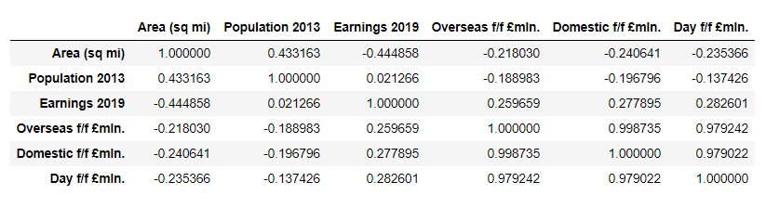
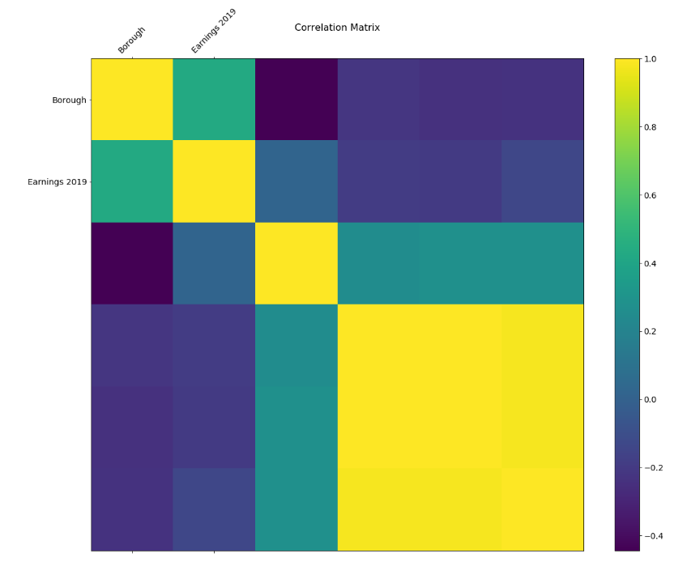
Correlation
I used matplotlib to visualised relationship between variables. I counted P-value.
Only Earning 2019 has P-value <<0.05

Slide 5
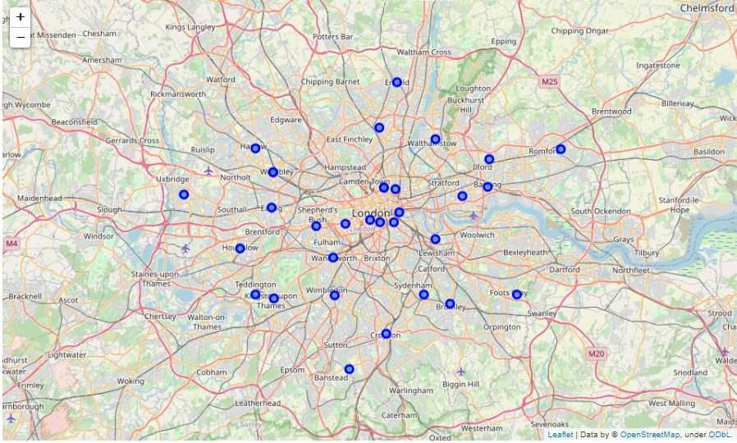
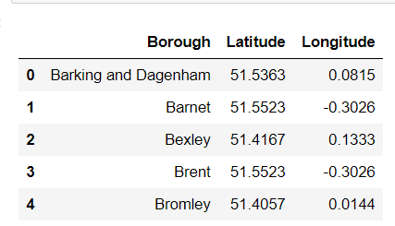
Getting coordinates & Visualise
I created specific csv file with London Borough obtaining information from Geo names organisation website. I visualised 32 borough on map using folium

Slide 6
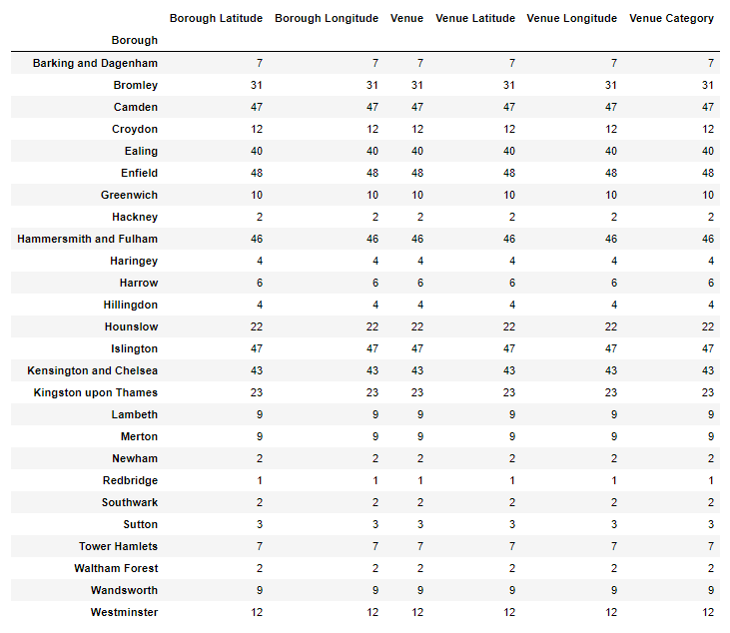
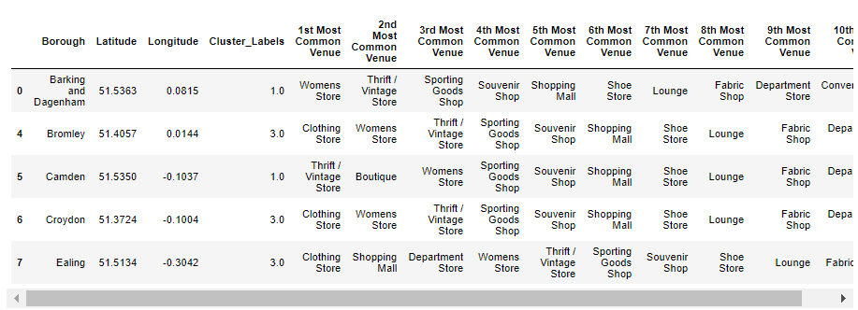
Utilizing the Foursquare API to explore the borough's and segment them
Retuned: 10 common venues for each of borough
Table showing number
of Venus category
for each borough

Slide 7
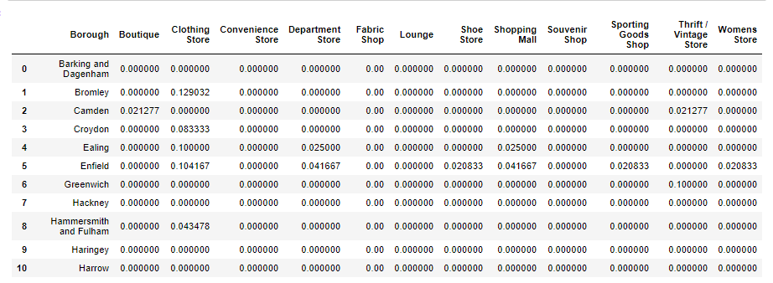
Creating new freq. Data for Retail Stores

Slide 8
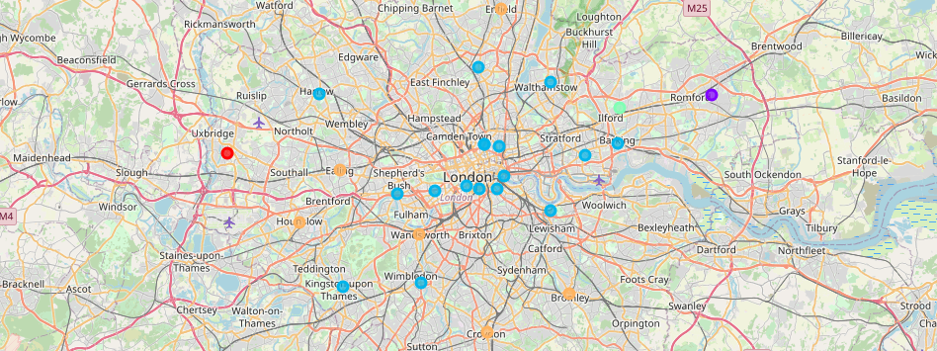
Results
I run the K-means clustering for London Retail store data. I visualised it by folium
Blue colour is related to cluster 3

Slide 9
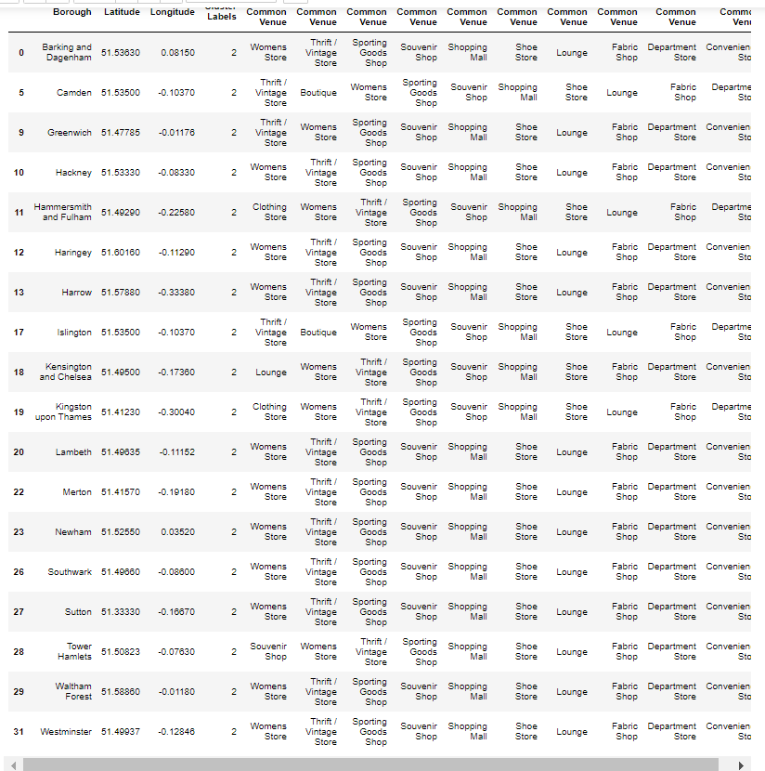
Discussion The goal was to provide information about location for new business Compering results of population, aera, earning and visitors spend we obtain 3 localization Westminster, Kingston and Chelsey, Camden. Annalise our biggest cluster3 all those localization are included. The most popular venues in cluster 3 are Women's Store, Clothing store and Vintage store On the other hand Closter 5 may be suitable for the business as well.. The most popular venues are Clothing store, Shopping Mall, Department store

Slide 10
Conclusion
This project concludes that 3 London Borough with the highest Income are potentially good for new business location
Tower Hamlet
Westminster
Islington
I have added that 2 other boroughs represent the highest spend by internal and external visitors. They are in cluster 3 and should be take for consideration as well.
Kingston and Chelsea
Camden

